Slide 1
Using Data from Insight to Locate and Explain Marsquakes
Maddy Sita & Suzan van der Lee

Slide 2
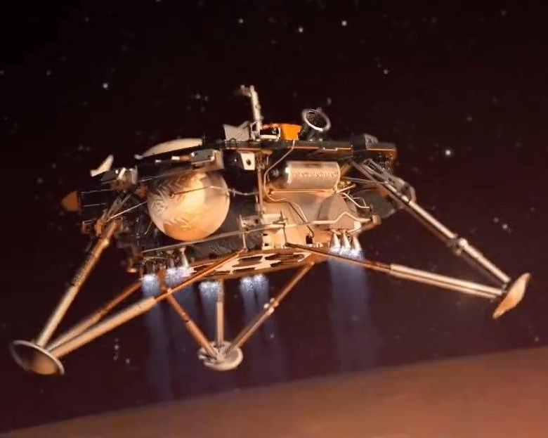
Background
Interior Exploration using Seismic Investigations, Geodesy and Heat Transport (InSight)
First successfully seismometer installed on the surface of Mars
With the goal of investigating the early formation processes of the rocky planets of our inner solar system
In addition to understanding of the current processes shaping the red planet

Slide 3
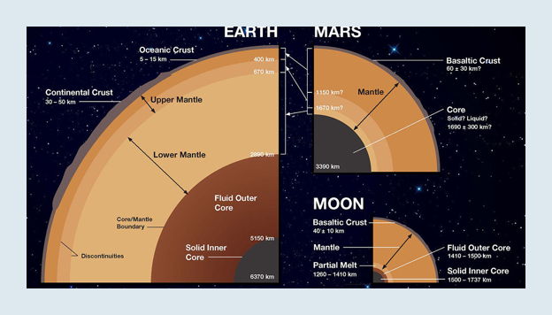
Everything we thought we knew...
Mars’ crust is composed of a single tectonic plate of unknown depth
The interior is also mostly unknown
Assumed that most seismic activity will be a result of intraplate tectonics, like faulting, and impacts
Orbital images show the most likely source of tectonic activity will be the Cerberus Fossae region

Slide 4
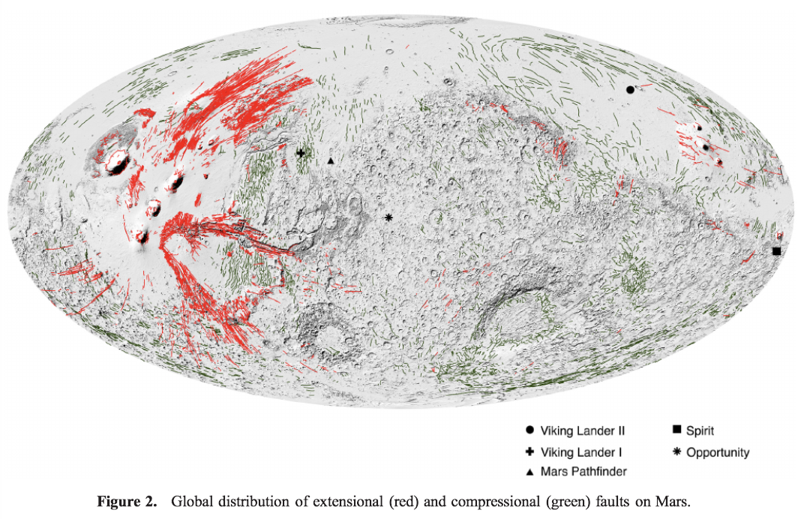
INSIGHT

Slide 5
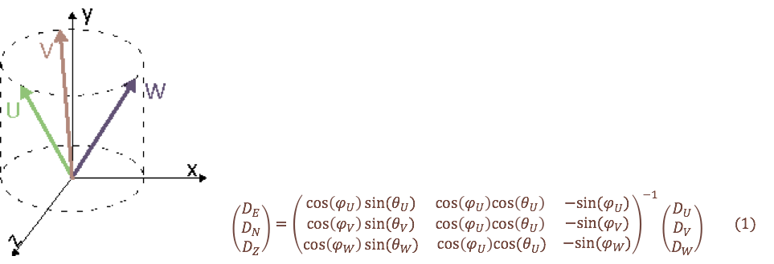
About the seismometer:
Contains 3 pendulums that record ground motion in three dimensions
Using Python package Obspy the raw data was downloaded directly and reorientated in the ENZ direction

Slide 6
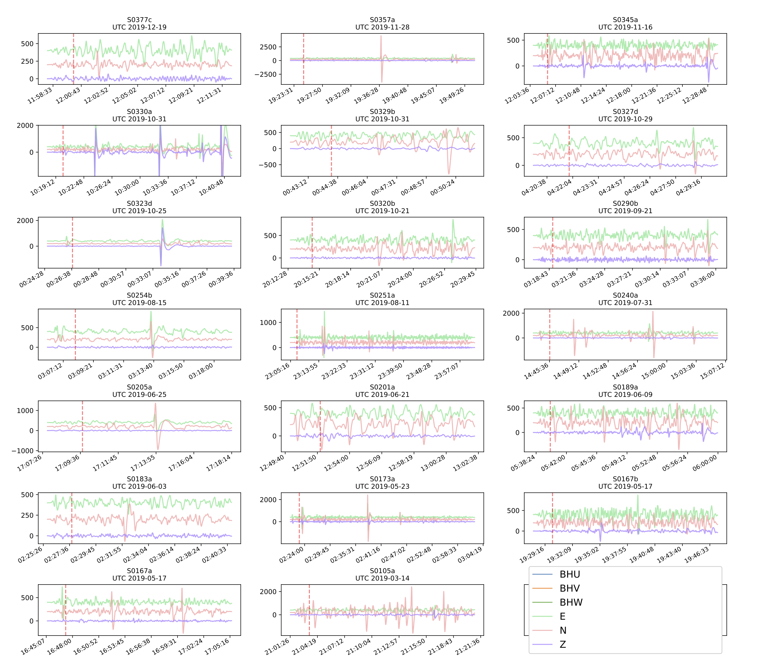
My job this summer...
Using the Mars Seismic Catalog provided by the Insight Marsquake Service (MQS) we categorized signals into possible low and high frequency events
Spanning over 1 January 2019 to 31 March 2020
Run through scripts to locate epicenter and estimate faulting mechanism

Slide 7
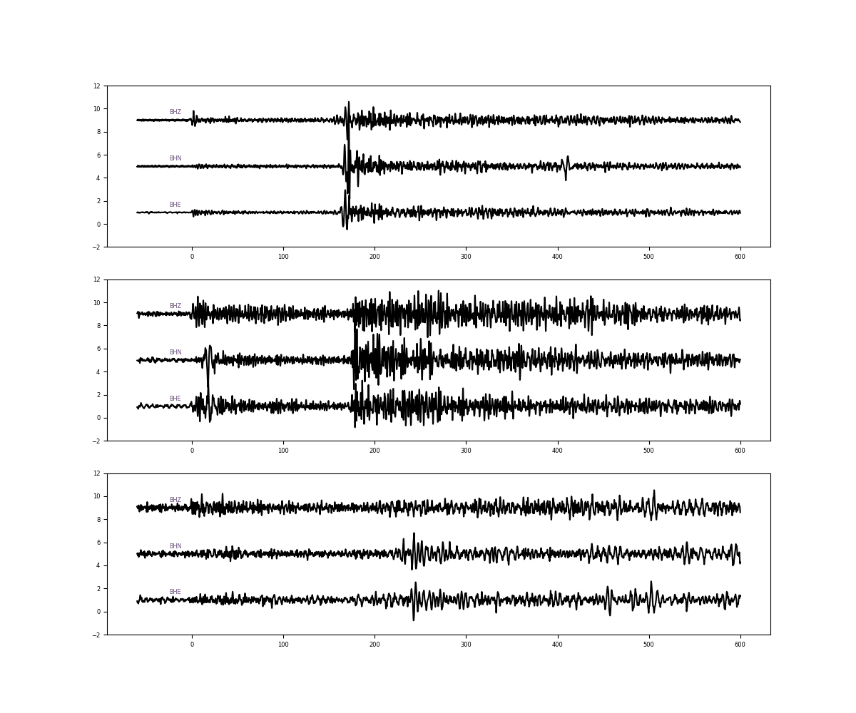
S0173a & S0235b
For reference we used two events previously published on to investigate the validity of a 3rd event that we discovered, S0325a.

Slide 8
S0325a seismogram…

Slide 9
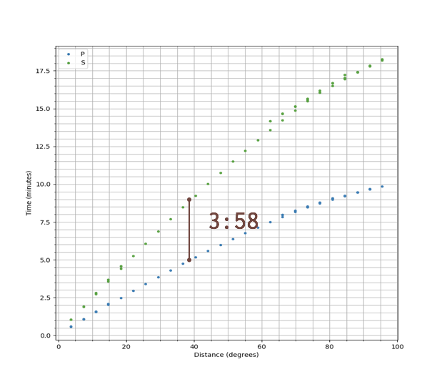
Locating the Marsquake
Travel Time Plot for Gudkova Model
By looking at the difference in travel time between the two waveforms, we can estimate the distance of the epicenter.
Based off the reference models and previously published locations, the Gudkova model best estimated the location.

Slide 10
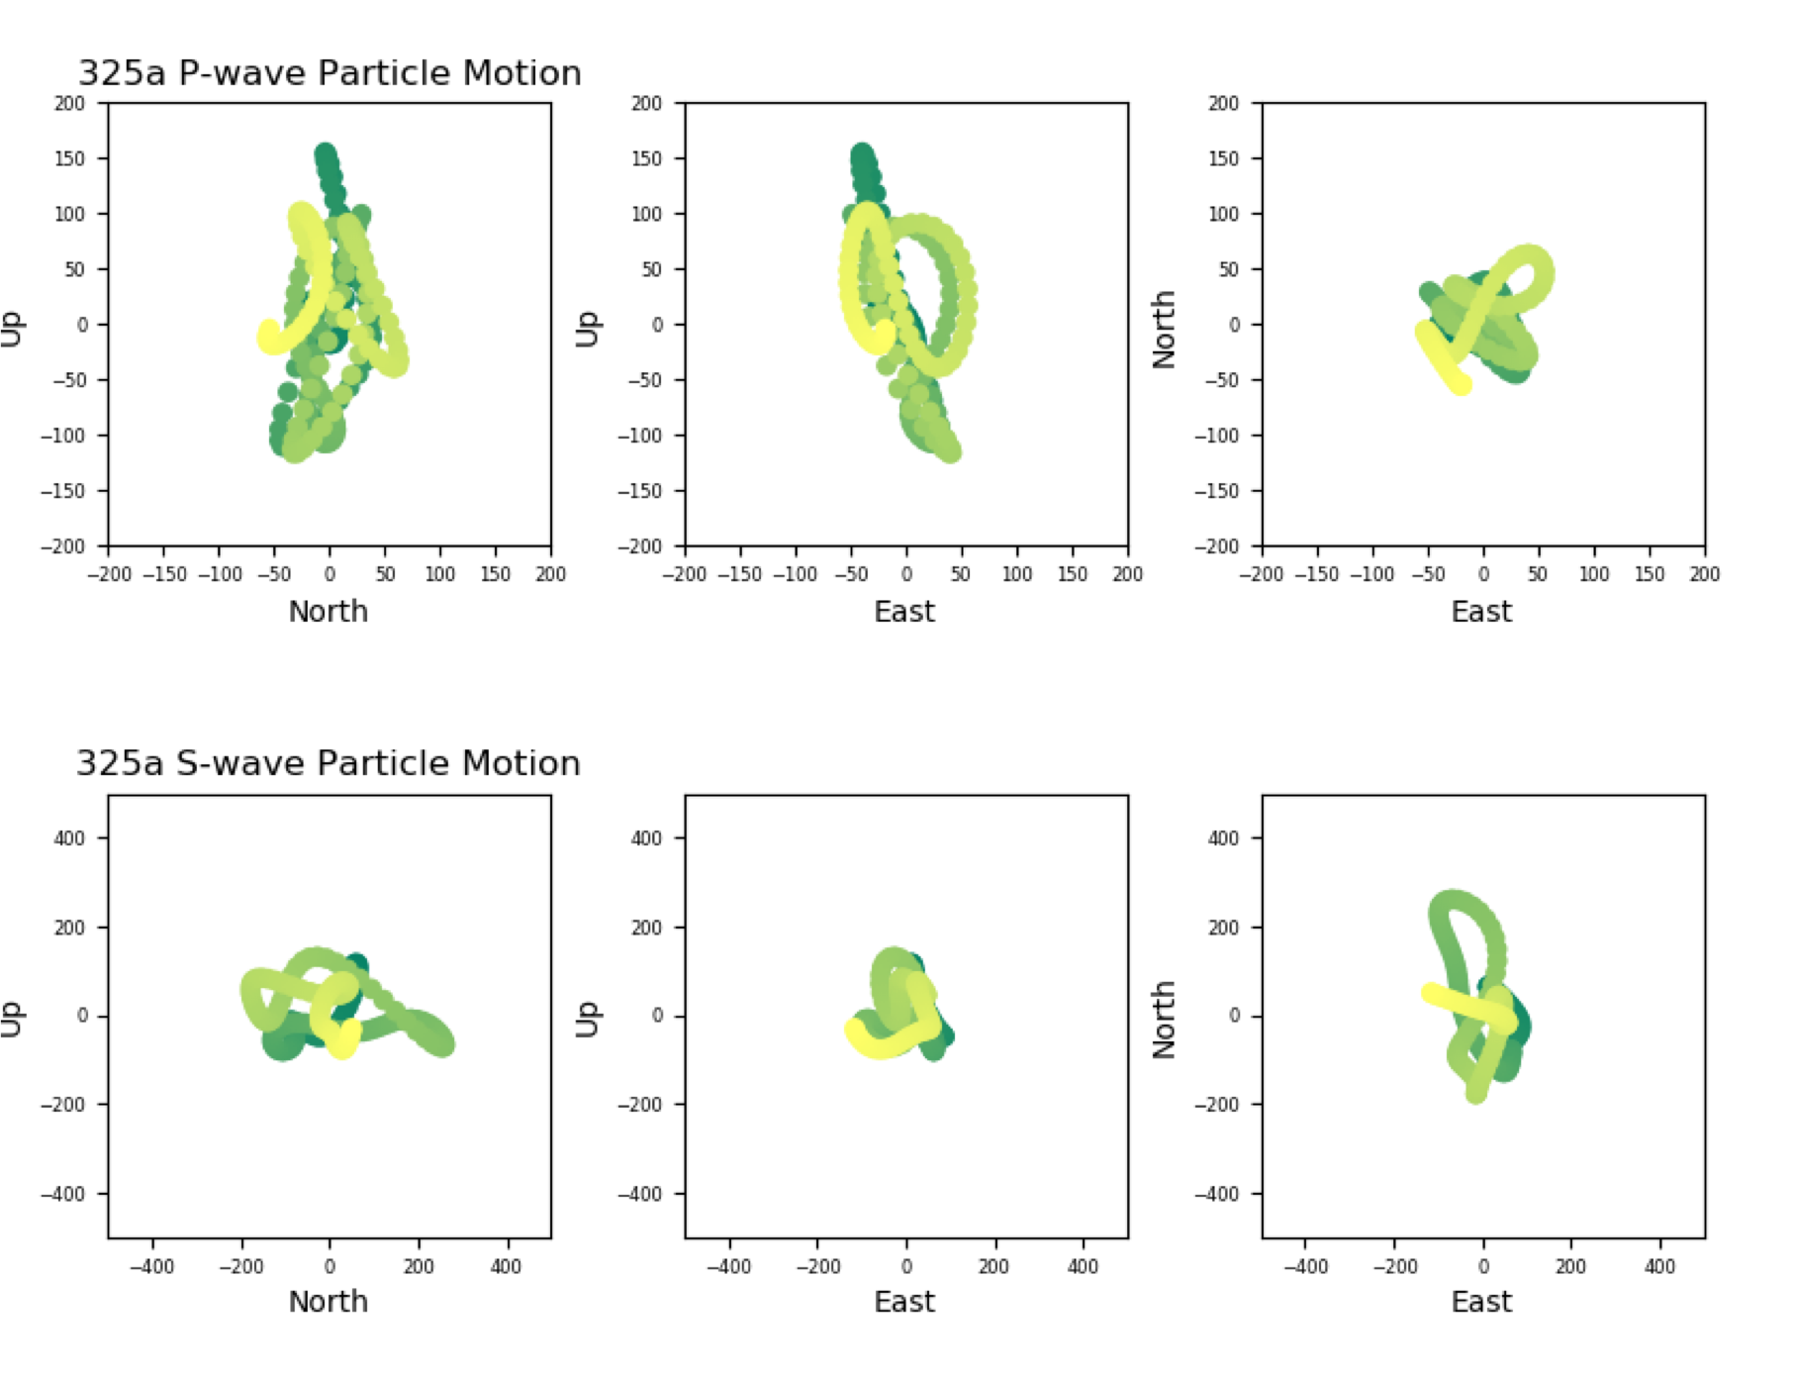
Locating the Marsquake
By tracking the particle motion, we can look at the direction from which the seismic waves are coming from.
Indicates the direction of the marsquake relative to the seismometer.
S0325a: SE

Slide 11
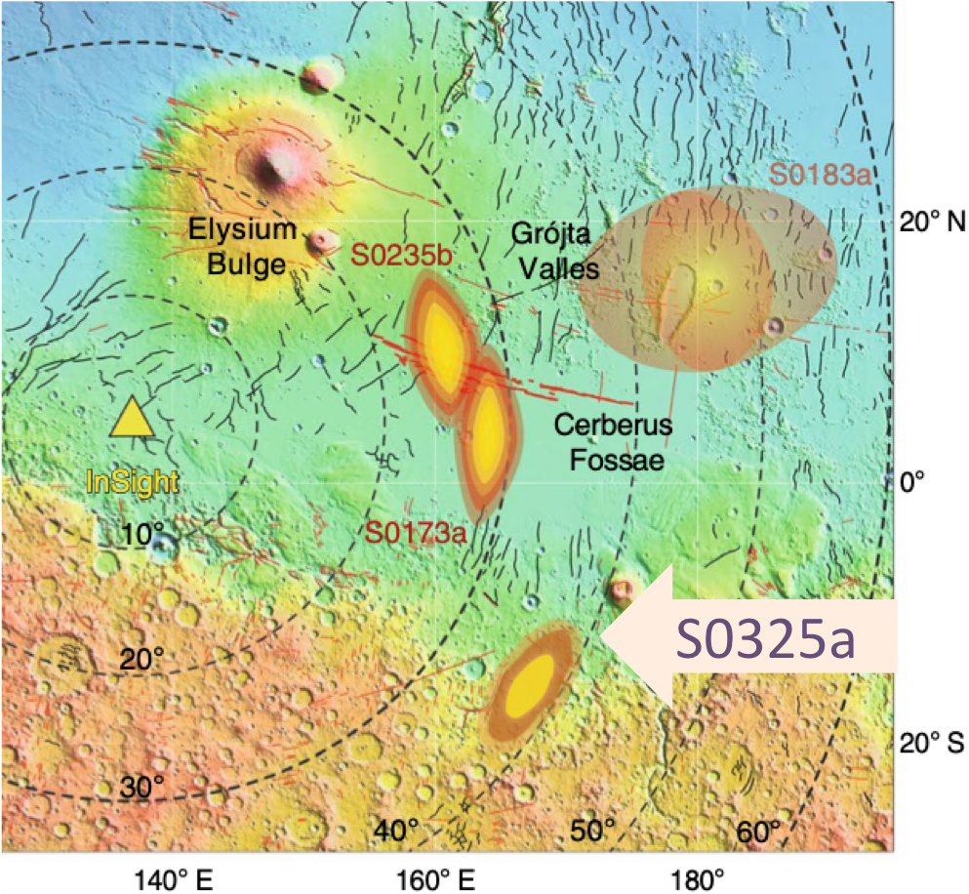
Map of Marsquakes
S0173a & S0235b
S0325b

Slide 12
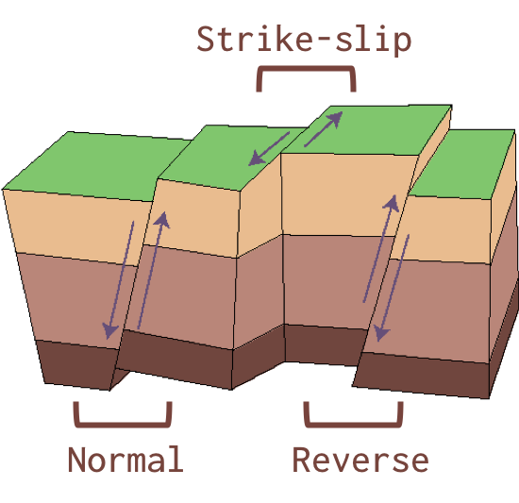
Estimating the Faulting Mechanism:
Calculated all different waveform amplitudes, incident angles & exit angles using all possible models over a range of fault types
Compared against actual waveform amplitudes of events
Determined fault plane orientation and created a range of possible ratios between modeled waveforms to compare to observed waveforms
Adjusted fault plane accordingly

Slide 13
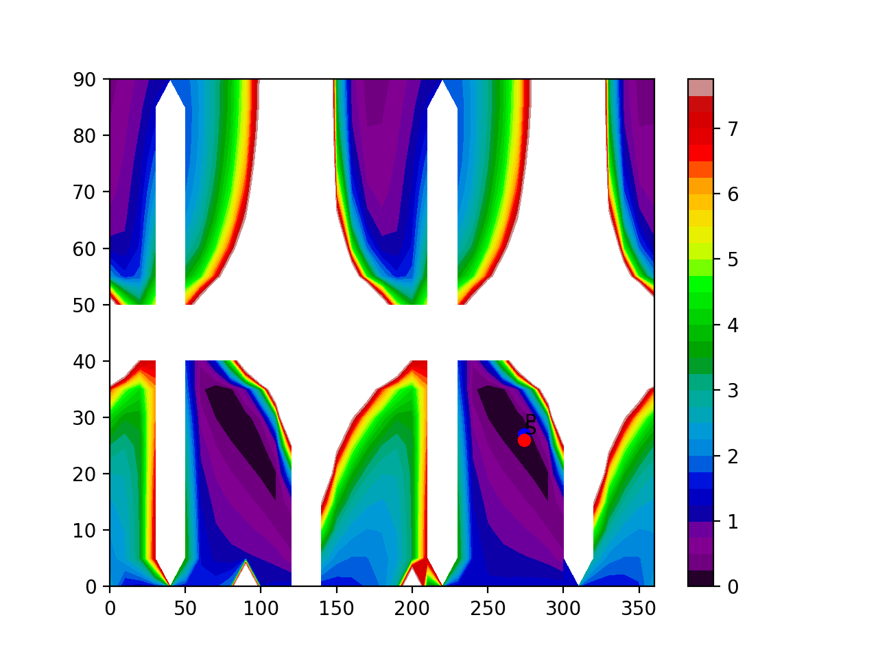
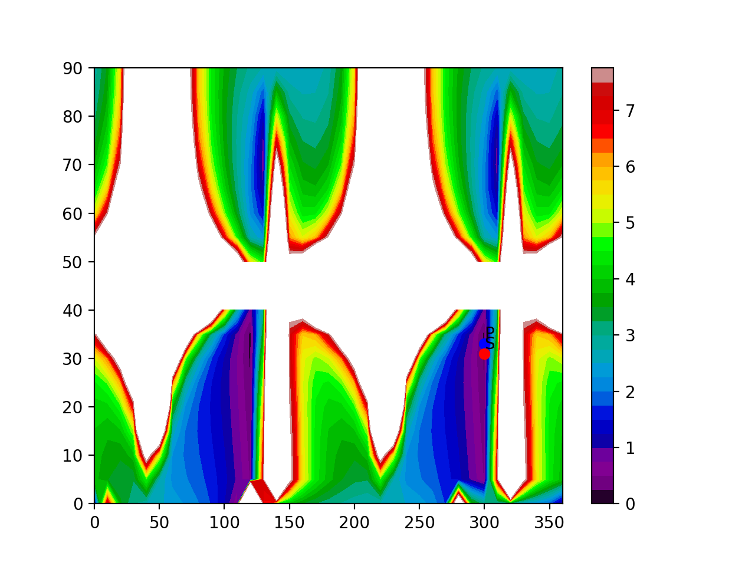
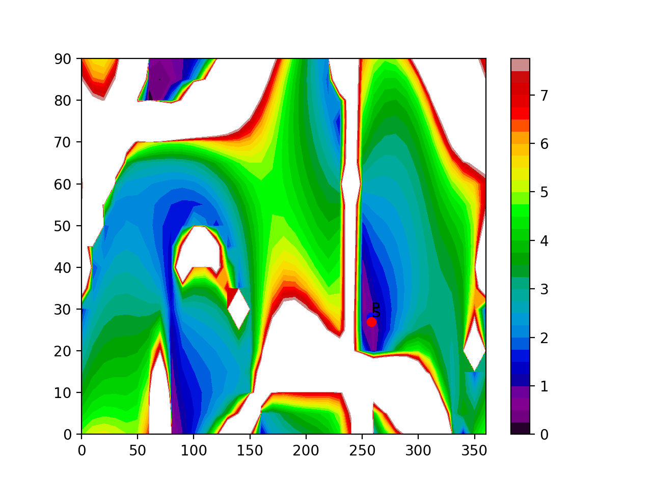
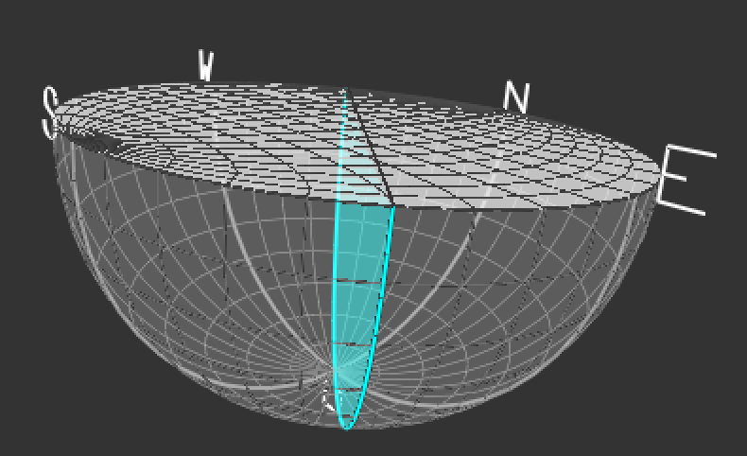
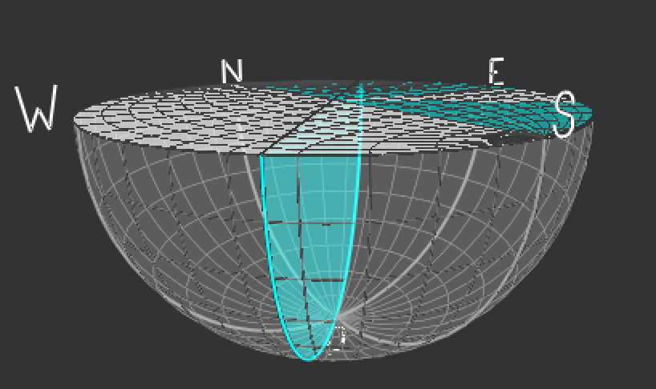
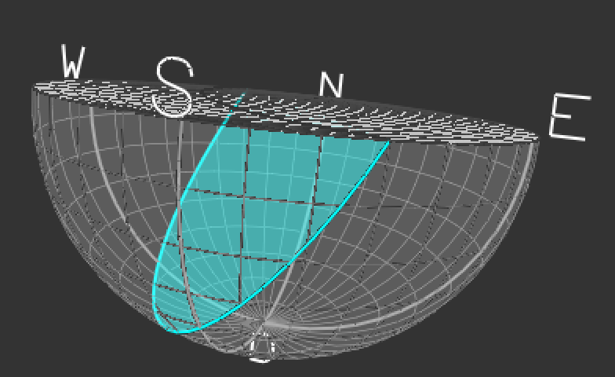
Estimating the Faulting Mechanism:
S0235b
S0325a
S0173a

Slide 14
So what does that mean?
Angles indicate a vertical dip-slip mechanism that doesn’t match the usual faulting mechanisms found on Earth
Landslide?
S0325a found near N/S hemisphere boundary, first of its kind close to the Martian southern highlands
All three indicate the possibility of a moving/second event based on particle motion plots
Secondary P/S wave arrival times have been reported by MQS which confirms it is not an artifact of the plotting method

